Slide 1
Clinical Management of the Novel Corona Virus Disease (COVID-19)
Module: 4
Developed with input from MOH, WHO,CDC,IDI

Slide 2
Introduction
Coronaviruses (CoV) are a large family of viruses that cause illness ranging from the common cold to more severe diseases such as
Middle East Respiratory Syndrome (MERS-CoV)
and Severe Acute Respiratory Syndrome (SARS-CoV).
A novel coronavirus (nCoV) is a new strain that has not been previously identified in humans.
Coronaviruses are zoonotic, meaning they are transmitted between animals and people.
Detailed investigations found that SARS-CoV was transmitted from civet cats to humans and MERS-CoV from dromedary camels to humans.
The A novel coronavirus (nCoV) has been proven to be transmitted from person to person.

Slide 3
The guidance in this presentation is based on WHO guidelines on COVID-19 developed in January 2020 and is intended for clinicians taking care of hospitalized adult and paediatric patients with severe acute respiratory infection (SARI) when COVID-19 infection is suspected or confirmed.
It is not meant to replace clinical judgment or specialist consultation but rather to strengthen clinical management of these patients and provide to up-to-date guidance.
Best practices for Severe Acute Respiratory Infection (SARI) including IPC and optimized supportive care for severely ill patients are essential and have formed the basis for the WHO guidelines.

Slide 4
Learning objectives
At the end of this session, you will be able to:
Describe general principles of managing the critically ill patient with severe acute respiratory infection (SARI) (due to COVID-19).
Describe IPC interventions at triage
Describe triage tools.
Recognize patients with uncomplicated COVID -19 with mild influenza-like illness.
Recognize patients with COVID-19 with SARI that need emergency care and hospitalization (including ICU admission).
Coordinate safe patient transfer.
HEALTH

Slide 5
Incubation Period
Current estimates by WHO (as of 27th January 2020) of the incubation period of the virus range from 2-10 days, and these estimates will be refined as more data become available. Understanding the time when infected patients may transmit the virus to others is critical for control efforts.
Detailed epidemiological information from more people infected is needed to determine the infectious period of 2019- nCoV, in particular whether transmission can occur from asymptomatic individuals or during the incubation period.
CDC Estimates the incubation period to be somewhere between 2-14 days.

Slide 6
Case Definition
Suspect case
A. Patients with severe acute respiratory infection (fever, cough, and requiring admission to hospital), AND with no other aetiology that fully explains the clinical presentation AND at least one of the following:
• a history of travel to or residence in the city of Wuhan, Hubei Province, China or any other country with a report of of COVID-19 Case in the 14 days prior tos symptom onset, or
• patient is a health care worker who has been working in an environment where severe acute respiratory infections of unknown aetiology are being cared for.
B. Patients with any acute respiratory illness AND at least one of the following: close contact with a confirmed or probable case of 2019-nCoV in the 14 days prior to illness onset, or visiting or working in a live animal market in Wuhan, Hubei Province, China or any other country with a report of of COVID-19 Case in the 14 days prior to symptom onset, or
• worked or attended a health care facility in the 14 days prior to onset of symptoms where patients with hospital-associated 2019-nCov infections have been reported

Slide 7
Suspect
1- Severe acute respiratory infection (SARI) in a person, with history of fever and cough requiring admission to hospital, with no other etiology that fully explains the clinical presentation1 (clinicians should also be alert to the possibility of atypical presentations in patients who are immunocompromised); AND any of the following:
a) A history of travel to Wuhan, Hubei Province China in the 14 days prior to symptom onset; or the disease occurs in a health care worker who has been working in an environment where patients with severe acute respiratory infections are being cared for, without regard to place of residence or history of travel; or
b) the person develops an unusual or unexpected clinical course, especially sudden deterioration despite appropriate treatment, without regard to place of residence or history of travel, even if another etiology has been identified that fully explains the clinical presentation.
2- A person with acute respiratory illness of any degree of severity who, within 14 days before onset of illness, had any of the following exposures:
close physical contact2 with a confirmed case of nCoV infection, while that patient was symptomatic; or
a healthcare facility in a country where hospital-associated nCoV infections have been reported;

Slide 9
Principles for caring for Patients Critically ill SARI patient
Recognize the critically ill patient early.
Apply appropriate IPC precautions immediately.
Treat the underlying aetiology as soon as possible.
Treat with evidence-based, supportive therapies as soon as possible.
Monitor-record-interpret-respond.
Deliver quality care.
If a patient is suspected to have a novel or emerging viral infection, notify health officials as soon as possible.
HEALTH

Slide 10
TRIAGE
Recognize and sort all patients with SARI at first point of contact with health care system (such as the emergency department). Consider nCOV as a possible etiology of SARI under certain conditions.
Use the surveillance case definition
Triage patients and start emergency treatments based on disease severity.

Slide 11
Triage
Conduct triage at the sick patient’s first point of contact with health care system.
Pre-hospital stage:
ambulance
clinic.
Hospital stage:
admissions ward
emergency area or department, accident and emergency department, casualty area
general ward.
HEALTH

Slide 12
Triage
Prioritize and sort patients based on their severity of illness and need for immediate care.
Use standardized triage tools to ensure reliability and valid sorting of patients
Avoid “under-triage” and “over-triage”.
Identify high priority patients that need immediate care.
HEALTH

Slide 13
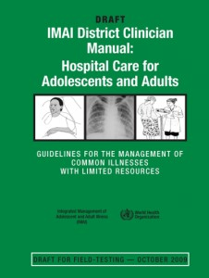
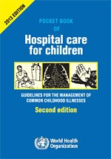
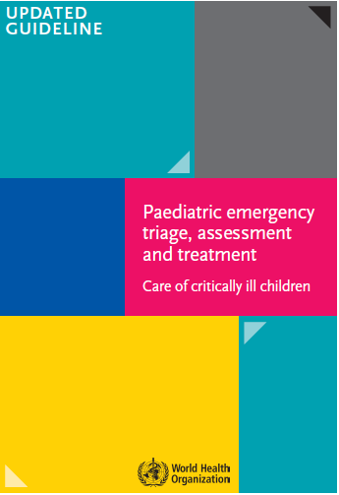
WHO hospital care handbooks
Emergency treatments for clinical use
IMAI quick check
Pocket book
IMCI emergency triage, assessment and treatment.
.
2011
2013
2016
HEALTH
EMERGENCIE
S

Slide 14
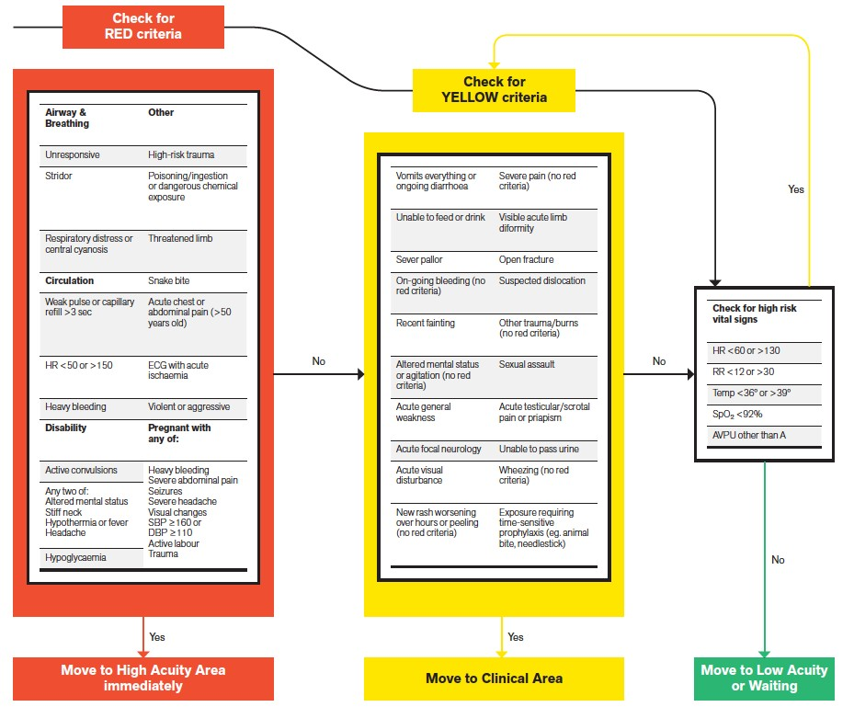
WHO – ICRC
Integrated Triage Tool
≽ 12 years
HEALTH

Slide 15
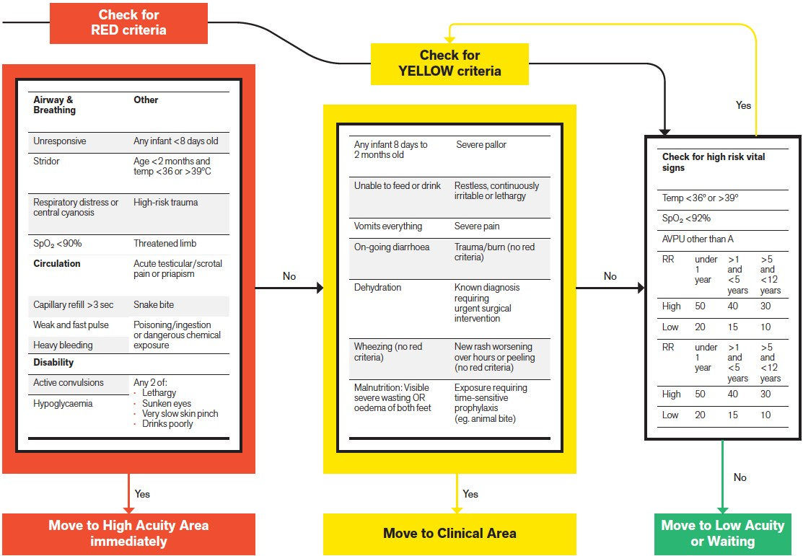
WHO – ICRC
Integrated Triage Tool
< 12 years
H
E
EALTH
MERGENCIES

Slide 16
Assess patients with ARI (suspect COVID-19)
Low-risk
patient
Hospitalization for monitoring OR*Discharge home with instructions to return if worsens or fails to improve.
Fever or history
of fever (≥ 38 °C)
+
Cough
+
Uncomplicated
Influenza-like illness
High-risk patient
Hospitalization for treatment and close monitoring.
Epidemiologic link
SARI*
complications
Hospitalization, consider ICU if critically ill. Treat with supportive care, antibiotics. Enrol in clinical trial for investigational therapeutics.
* Home care an be considered in settings when health system is unable to isolate patients in health care settings. Use WHO home care guidance: https://www.who.int/emergencies/diseases/novel-coronavirus- 2019/technical-guidance
HEALTH
EMERGENCIES
programme

Slide 17
Risk factors for severe disease- who is at risk for severe disease?
Comorbidities
cardiovascular disease (cardiac failure)
pulmonary disease (asthma and COPD)
metabolic disease (diabetes)
kidney disease
hepatic disease
haemoglobinopathies
chronic neurologic conditions (neuromuscular, neurocognitive and seizure disorders).
Extremes of age
infants and young children (< 2 years)
elderly (≥ 65).
Immunosuppressive conditions
HIV, immunosuppressive medication, malignancy.
Special situations
children receiving chronic aspirin therapy
pregnancy (up to 2 weeks’ postpartum).
High risks groups should be considered for hospitalization even with mild disease, for close monitoring to detect deterioration
and treatment
HEALTH

Slide 18
Clinical Signs and symptoms of COVID-19

Slide 20
Management of Clinical Syndromes including IPC measures required in the Hospital Setting

Slide 21
CLINICAL SYNDROMES ASSOCIATED WITH COVID-19
Uncomplicated illness -Patients with uncomplicated upper respiratory tract viral infection, may have non-specific symptoms such as fever, cough, sore throat, nasal congestion, malaise, headache, muscle pain or malaise.
Pneumonia- Patient with pneumonia and no signs of severe pneumonia.
Severe Pneumonia: Patients with signs of Severe Pneumonia
Acute Respiratory Distress Syndrome
Sepsis - life-threatening organ dysfunction caused by a dysregulated host response to suspected or proven infection.
Septic Shock

Slide 22
PRINCIPLES OF CLINICAL MANGEMENT OF COVID-19 DISEASE.
Triage: recognize and sort patients with SARI
Immediate implementation of appropriate infection prevention and control (IPC) measures
Early supportive therapy and monitoring.
Collection of specimens for laboratory diagnosis.
Management of hypoxemic respiratory failure and acute respiratory distress syndrome (ARDS)
Management of septic shock
Prevention of complications
Specific anti-COVID virus (antiviral) treatments
Special considerations for pregnant patients

Slide 23
Immediate appropriate IPC) measures
At triage-
Give suspect patient a medical mask and direct patient to separate area, an isolation room if available.
Keep at least 1 meter distance between suspected patients and other patients.
Instruct all patients to cover nose and mouth during coughing or sneezing with tissue or flexed elbow for others.
Perform hand hygiene after contact with respiratory secretions

Slide 24
Apply droplet precautions
Droplet precautions prevent large droplet transmission of respiratory viruses:
Use a medical mask if working within 1-2 metres of the patient.
Place patients in single rooms, or group together those with the same etiological diagnosis.
If an etiological diagnosis is not possible, group patients with similar clinical diagnosis and based on epidemiological risk factors, with a spatial separation.
When providing care in close contact with a patient with respiratory symptoms (e.g. coughing or sneezing), use eye protection (face-mask or goggles), because sprays of secretions may occur.
Limit patient movement within the institution and ensure that patients wear medical masks when outside their rooms.

Slide 25
Apply contact precautions -
Droplet and contact precautions prevent direct or indirect transmission from contact with contaminated surfaces or equipment (i.e. contact with contaminated oxygen tubing / interfaces):
Use PPE (medical mask, eye protection, gloves and gown) when entering room and remove PPE when leaving. If possible, use either disposable or dedicated equipment (e.g. stethoscopes, blood pressure cuffs and thermometers).
If equipment needs to be shared among patients, clean and disinfect between each patient use.
Ensure that health care workers refrain from touching their eyes, nose, and mouth with potentially contaminated gloved or ungloved hands.
Avoid contaminating environmental surfaces that are not directly related to patient care (e.g. door handles and light switches). Ensure adequate room ventilation. Avoid movement of patients or transport. Perform hand hygiene.

Slide 26
Early supportive therapy and monitoring.
Give supplemental oxygen therapy immediately to patients with SARI and respiratory distress, hypoxaemia, or shock.
Use conservative fluid management in patients with SARI when there is no evidence of shock.
Give empiric antimicrobials to treat all likely pathogens causing SARI. Give antimicrobials within one hour of initial patient assessment for patients with sepsis.
Do not routinely give systemic corticosteroids for treatment of viral pneumonia or ARDS outside of clinical trials unless they are indicated for another reason.

Slide 27
1. Uncomplicated Illnes
Patients with uncomplicated upper respiratory tract viral infection, may have non-specific symptoms such as:
fever,
cough,
sore throat,
nasal congestion,
malaise, headache,
muscle pain or malaise.
The elderly and immunosuppressed may present with atypical symptoms.
These patients do not have any signs of dehydration, sepsis or shortness of breath.

Slide 28
Mgt
In view of the currently limited knowledge of the disease caused by COVID-19 infection and its transmission patterns, WHO recommends that suspected cases of COVID-19 infection be isolated and monitored in a hospital setting.
This would ensure both safety and quality of health care (in case patients’ symptoms worsen) and public health security.
Isolation outside the hospital setting may be considered on a case-by-case basis; in situations where isolation in the hospital is not possible.
THE DECISION TO ISOLATE AT HOME WILL BE CONSIDEERD ON A CASE-BY -CASE BASIS AND THE DECISION MUST BE TAKEN JOINTLY BY A CLINICAL TEAM WITH ADEQUATE PROVISION FOR FOLLOW UP OF THE PATIENTS
(WHO guidance on home isolation is available for reference)

Slide 29
2. Pneumonia
Patient with pneumonia and no signs of severe pneumonia.
Child with non-severe pneumonia has cough or difficulty breathing + fast breathing: fast breathing (in breaths/min): <2 months, ≥60; 2–11 months, ≥50; 1–5 years, ≥40 and no signs of severe pneumonia

Slide 30
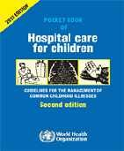
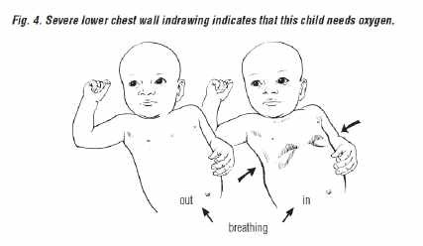
Recognize pneumonia in children
Pneumonia
≥ 50 breaths/min in child aged 2–12 months
≥ 40 breaths/min in child aged 1–5 years
chest indrawing
HEALTH

Slide 31
Treatment of Pneumonia
Antibiotic treatment should be provided for patients with SARI who meet the criteria for diagnosis of Pneumonia:
Adults and Children >5 years :
Give Amoxicillin 500 mg-1 g every 8 hours for 5 days:
Children:
Give Amoxicillin 40 mg/kg every 12 hours for 5 days.
Preferably use dispersible tablets in younger children

Slide 32
Recognize Severe pneumonia
Severe pneumonia
Cough or difficulty breathing and
≥ 1 of the following:
signs of pneumonia with a general danger sign:
lethargy or unconscious
convulsions
inability to breastfeed or drink.
central cyanosis, SpO₂ < 90%
severe respiratory distress
grunting, very severe chest indrawing.
HEALTH

Slide 33
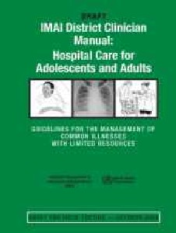
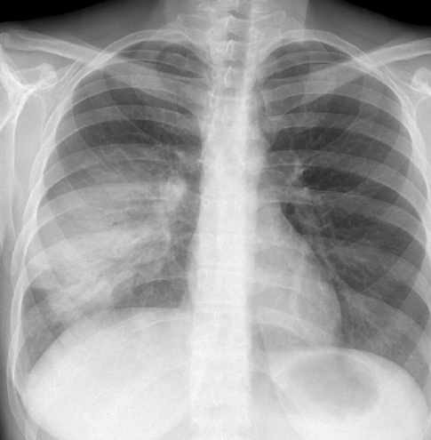
Recognize pneumonia in children
Fever and cough
RR > 30/min
SpO₂ < 90% on room air
Severe respiratory distress:
inability to speak
use of accessory muscles.
Courtesy of Dr. Harry Shulman at http://chestatlas.com/cover.htm
HEALTH

Slide 34
Pneumonia severity scores (1/2)
Severity scores can guide decision-making process regarding hospitalization and ICU admission:
must be used alongside clinical judgement
validate scoring system in your setting.
For example, the CURB-65 score includes:
Confusion
Urea > 7 mmol/L
RR ≥ 30 breaths/min
Blood pressure (SBP < 90 mmHg or DBP ≤ 60 mmHg)
– Age > 65.
HEALTH

Slide 35
Pneumonia severity scores (2/2)
Higher score is associated with higher risk of death:
score 0–1, low risk of death
may be suitable for treatment at home, always take into account the patient’s social circumstances and wishes
score 2, moderate risk of death,
consider for short stay hospitalization or close outpatient treatment
score ≥ 3, high risk of death
4–5 consider for ICU hospitalization.
HEALTH

Slide 36
3. Severe Pneumonia – Diagnostic criteria
Adolescent or adult: fever or suspected respiratory infection, plus one of respiratory rate >30 breaths/min, severe respiratory distress, or SpO2 <90% on room air.
Child: with cough or difficulty in breathing, plus at least one of the following:
central cyanosis or SpO2 <90%; severe respiratory distress (e.g. grunting, very severe chest indrawing); signs of pneumonia with a general danger sign: inability to breastfeed or drink, lethargy or unconsciousness, or convulsions.
Other signs of pneumonia in children may be present: chest indrawing, fast breathing (in breaths/min): <2 months, ≥60; 2–11 months, ≥50; 1–5 years, ≥40.2 The diagnosis is clinical; chest imaging can exclude complications.

Slide 37
Treatment of Severe Pneumonia
CHILDREN (<5 YEARS)
a) Give intravenous ampicillin (or benzyl penicillin) and gentamicin
Ampicillin 50 mg/kg or benzyl penicillin 50 000 U/kg IM or IV every 6 h for at least 5 days AND Gentamicin 7.5 mg/kg IM or IV once a day for at least 5 days.
b) Give supplemental oxygen therapy immediately to patients with SARI and respiratory distress, hypoxemia,
Use nasal prongs as the preferred method of oxygen delivery to young infants; if not available, a nasal or nasopharyngeal catheter may be used.
Administer the oxygen using a nasal prongs or nasopharyngeal catheter at the following flow Rates:
0.5-1L/MIN for neonates
1-2L/MIN for infants
1-4L/MIN for Older Children

Slide 38
Give oxygen to all children with oxygen saturation < 90%. Use a pulse oximetry to guide oxygen therapy (to keep oxygen saturation at >90%).
If a pulse oximeter is not available, continue oxygen until the signs of hypoxia (such as inability to breastfeed or breathing rate ≥ 70/min) are no longer present.
Remove oxygen for a trial period each day for stable children while continuing to use a pulse oximeter to determine oxygen saturation. Discontinue oxygen if the saturation remains stable at > 90% (at least 15 min on room air).
Health workers taking care of the children should carry out a check every 3 hrs to ensure that the nasal prongs are not blocked
ADULTS AND CHILDREN>5 YEARS

Slide 39
4. Acute Respiratory Distress Syndrome (ARDS) –
Rapid progression of severe respiratory distress:
severe shortness of breath
inability to complete full sentences
tachypnoea
use of accessory muscles of respiration
cyanosis (very severe).
HEALTH

Slide 40
ARDS - Diagnostic criteria
Severe hypoxaemia requiring high-flow oxygen therapy:
– SpO₂/FiO₂ ≤ 315 or
SpO₂/FiO₂ ≤ 264.
Early recognition and implementation of lung protective ventilation saves lives.
HEALTH

Slide 41
ARDS - Diagnostic criteria
Berlin defnition, JAMA 2012
Acute onset
≤1 week of known insult or new or worsening respiratory status.
Origin of oedema:
Respiratory failure not fully explained by cardiac failure or fluid overload.
Need objective assessment (e.g. echocardiography) to exclude hydrostatic cause of oedema if no risk factor present.
HEALTH

Slide 42
Berlin definition, JAMA 2012
3. Severity of oxygenation impairment (if ABG available)
Disease severity | PaO₂/FiO₂ | PEEP
Mild ARDS | 200 < x ≤ 300 | ≥ 5 cm H₂O (or CPAP)
Moderate ARDS | 100 < x ≤ 200 | ≥ 5 cm H₂O
Severe ARDS | x ≤ 100 | ≥ 5 cm H₂O
*If altitude is higher than 1000 m, then correction factor should beE calculated as follows: PaO₂/FiO₂ x barometric pressure/760^{H}m^{EAL}m^{TH} Hg.

Slide 43
ARDS in resource-limited settings
Kigali-modification of Berlin criteria clinical
Challenge Adaptation
No arterial blood gas analyser to assess degree of hypoxaemia
SpO₂/FiO₂
≤ 315 is ARDS
No mechanical ventilation
Remove PEEP and CPAP from definition
No chest radiograph or CT scan Use ultrasound to document
bilateral chest opacities
HEALTH
EMERGENCIES
programme

Slide 44
ARDS in infants and children (1/2)
International consensus statement suggests alternate definition for infants and children.
Challenge | Adaptation
Arterial blood gas | SpO₂ is acceptable
analysis less commonly used in children | alternative to PaO₂ PaO₂/FiO₂ ≤ 300 or
 | SpO₂ /FiO₂ ≤ 264
HEALTH
EMERGENCIES

Slide 45
ARDS in infants and children (2/2)
Disease severity | OSI (oxygen saturation index) | Oxygen index (OI)
Mild ARDS | 5 ≤ x < 7.5 | 4 ≤ x < 8
Moderate ARDS | 7.5 ≤ x < 12.3 | 8 ≤ x < 16
Severe ARDS | ≥ 12.3 | ≥ 16
OSI = FiO₂ X (mean airway pressure X 100)/SpO₂ OI = FiO₂ X (mean airway pressure X 100)/PaO₂ Mean airway pressure = (Ti x PIP) + (Te x PEEP) ÷Tt
HEALTH
EMERGENCI
ES

Slide 46
4. Acute respiratory distress syndrome (ARDS) – Diagnostic Criteria
Onset: new or worsening respiratory symptoms within one week of known clinical insult.
Chest imaging (radiograph, CT scan, or lung ultrasound): bilateral opacities, not fully explained by effusions, lobar or lung collapse, or nodules.
Origin of oedema: respiratory failure not fully explained by cardiac failure or fluid overload. Need objective assessment (e.g. echocardiography) to exclude hydrostatic cause of oedema if no risk factor present.

Slide 47
Oxygenation (adults):
Mild ARDS: 200 mmHg < PaO2/FiO2 ≤ 300 mmHg (with PEEP or CPAP ≥5 cmH2O,7 or non-ventilated8)
Moderate ARDS: 100 mmHg < PaO2/FiO2 ≤200 mmHg with PEEP ≥5 cmH2O,7 or non-ventilated8)
Severe ARDS: PaO2/FiO2 ≤ 100 mmHg with PEEP ≥5 cmH2O,7 or non-ventilated8)
When PaO2 is not available, SpO2/FiO2 ≤315 suggests ARDS (including in non-ventilated patients)

Slide 48
ARDS- Diagnostic criteria
Oxygenation (children; note OI = Oxygenation Index and OSI = Oxygenation Index using SpO2):
Bilevel NIV or CPAP ≥5 cmH2O via full face mask: PaO2/FiO2 ≤ 300 mmHg or SpO2/FiO2 ≤264
Mild ARDS (invasively ventilated): 4 ≤ OI < 8 or 5 ≤ OSI < 7.5
Moderate ARDS (invasively ventilated): 8 ≤ OI < 16 or 7.5 ≤ OSI < 12.3
Severe ARDS (invasively ventilated): OI ≥ 16 or OSI ≥ 12.3

Slide 49
ARDS Treatment
Management of ARDS needs to be done in an intensive care setting with appropriate facility and medical expertise.
A: Recognize severe hypoxemic respiratory failure when a patient with respiratory distress is failing standard oxygen therapy.
This may manifest as Patients continuing to have increased work of breathing or hypoxemia even when oxygen is delivered via a face mask with reservoir bag (flow rates of 10-15 L/min, which is typically the minimum flow required to maintain bag inflation; FiO2 0.60-0.95)..
B) : Endotracheal intubation should be Immediately performed by a trained and experienced provider (anesthesiologist / critical care specialist) using airborne precautions.
Due to the fact that Patients with ARDS, especially young children or those who are obese or pregnant, may desaturate quickly during intubation, there is need to take precaution before intubation. Pre-oxygenate with 100% FiO2 for 5 minutes, via a face mask with reservoir bag, bag-valve mask, HFNO, or NIV prior to a rapid sequence intubation.

Slide 50
ARDS Treatment (cont’d)
C: Implement mechanical ventilation using lower tidal volumes (4–8 ml/kg predicted body weight, PBW) and lower inspiratory pressures (plateau pressure <30 cmH2O).
D: In patients with severe ARDS, prone ventilation for >12 hours per day is recommended and pplication of prone ventilation is strongly recommended for adult and Paediatric patients with severe ARDS but requires sufficient human resources and expertise to be performed safely
E: Use of a conservative fluid management strategy for ARDS patients without tissue hypo perfusion is strongly recommended to shorten the duration of ventilation.
NOTE: High-flow nasal oxygen (HFNO) or non-invasive ventilation (NIV) should only be used in selected patients with hypoxemic respiratory failure. The risk of treatment failure is high in patients with MERS treated with NIV, and patients treated with either HFNO or NIV should be closely monitored for clinical deterioration.

Slide 51
6. Sepsis – Diagnostic Criteria (Adults)
Adults: life-threatening organ dysfunction caused by a dysregulated host response to suspected or proven infection, with organ dysfunction*.
Signs of organ dysfunction include:
altered mental status,
difficult or fast breathing,
low oxygen saturation,
reduced urine output,
fast heart rate, weak pulse,
cold extremities or low blood pressure,
skin mottling, or laboratory evidence of coagulopathy,
thrombocytopenia,
acidosis,
high lactate or
hyperbilirubinemia.

Slide 52
Clinical features of shock in child
Mental status alteration:
irritability, inappropriate crying, confusion, poor interactions
drowsiness, poor interaction, lethargy, or unarousable.
Capillary refill abnormalities:
prolonged capillary refill
flash capillary refill.
Abnormal peripheral pulses:
weak distal pulses
widened pulse pressure (bounding pulses).
Cool or mottled extremities
Hypotension (late finding in children)
HEALTH

Slide 53
Shock definition WHO ETAT 2016
The presence of all three clinical criteria required to diagnose shock:
delayed capillary refill > 3 sec, and
cold extremities, and
weak and fast pulse.
or, frank hypotension (age-related SBP or MAP).
Age | < 1 month | 1–12 months | 1–12 years | > 12 years
SBP | < 50 | < 70 | 70 + (2 × age) | < 90
HEALTH

Slide 54
Sepsis – Diagnostic Criteria (Children)
Children:
Suspected or proven infection and ≥2 Systemic Inflammatory Respone Syndrome (SIRS) criteria:
(Fever of more than 38°C (100.4°F) or less than 36°C (96.8°F),
Heart rate of more than 90 beats per minute,
Respiratory rate of more than 20 breaths per minute or arterial carbon dioxide tension (PaCO₂) of less than 32 mm Hg,
Abnormal white blood cell count (>12,000/µL or < 4,000/µL or >10% immature [band] forms) of which one must be abnormal temperature or white blood cell count.

Slide 55
Sepsis - Treatment
A: ADULTS:
Give empirical IV antimicrobials within the first hour. This is crucially important.
Give Ceftriaxone (1 gram daily IV) or ampicillin 2 grams every 6 hours plus gentamicin 7.0 mg/kg IV every 24 hours.
B: CHILDREN:
Start the child immediately on antibiotics.
Give IV Ampicillin at 50 mg/kg every 6 h plus IV Gentamicin 7.5 mg/kg once a day for 7–10 days; alternatively, give ceftriaxone at 80–100 mg/kg IV once daily over 30–60 min for 7–10 days.
When Staphylococcal infection is strongly suspected, give Flucloxacillin at 50 mg/kg every 6 h IV plus IV Gentamicin at 7.5 mg/kg once a day

Slide 56
5. Septic shock – Diagnostic criteria
Adults: persisting hypotension despite volume resuscitation, requiring vasopressors to maintain MAP ≥65 mmHg and serum lactate level >2 mmol/L.
Children: any hypotension (SBP <5th centile or >2 SD below normal for age) or 2-3 of the following:
altered mental state;
tachycardia or bradycardia (HR <90 bpm or >160 bpm in infants and HR <70 bpm or >150 bpm in children);
prolonged capillary refill (>2 sec) or warm vasodilation with bounding pulses;
tachypnea;
mottled skin or petechial or purpuric rash;
increased lactate;
oliguria;
Hyperthermia or hypothermia.

Slide 57
Septic shock - Treatment
A: ADULTS:
Give empirical IV antimicrobials within the first hour. This is crucially important. Give Ceftriaxone (1 gram daily IV) or ampicillin 2 grams every 6 hours PLUS Gentamicin 7.0 mg/kg IV every 24 hours.
Give 1000 ml Ringers Lactate (RL) or Normal Saline (NS) bolus.
After the initial 1000 ml Ringers Lactate (RL) or Normal Saline (NS) bolus, give RL or NS at 20 ml/kg/hour, not to exceed a maximum of 60 ml/kg in the first 2 hours (including the initial bolus).
Monitor SBP and clinical signs of perfusion (urine output, mental status).
Consider adding vasopressors if SBP remains <90 and signs of poor perfusion continue after fluid resuscitation (estimated 60 ml/kg) even within first 2 hours.
At 2–6 hours, if SBP remains below 90 and signs of poor perfusion continue, continue fluids at 5–10 ml/kg/hour.
At 2–6 hours, if SBP rises above 90, continue fluids at 2 ml/kg/hour. However, if the pulse is still high and there are other signs of poor perfusion, patient may still be volume-depleted and need more fluids.
Watch carefully for signs of fluid overload (increased JVP, increasing crackles or rales on auscultation). If present, decrease the rate of fluid administration

Slide 58
B: CHILDREN:
START THE CHILD IMMEDIATELY ON ANTIBIOTICS.
Give IV ampicillin at 50 mg/kg every 6 h plus IV gentamicin 7.5 mg/kg once a day for 7–10 days; alternatively, give ceftriaxone at 80–100 mg/kg IV once daily over 30–60 min for 7–10 days.
When staphylococcal infection is strongly suspected, give flucloxacillin at 50 mg/kg every 6 h IV plus IV gentamicin at 7.5 mg/kg once a day.
Give oxygen as per the recommended amount.
Treat septic shock with rapid IV infusion of 20 ml/kg of normal saline or Ringer’s lactate. Reassess.
If the child is still in shock, repeat 20 ml/kg of fluid up to 60 ml/kg in the first hour.
If the child is still in shock (fluid-refractory shock) give a blood transfusion of 20 ml/kg fresh whole blood or 10 ml/kg of packed cells, the rate of infusion depending on the circulatory status.

Slide 59
SUPPORTIVE CARE
If the child has a high fever (≥ 39 °C or 102.2 °F) that is causing distress or discomfort, give paracetamol or ibuprofen.
Monitor Hb or EVF, and, when indicated, give a blood transfusion of 20 ml/kg fresh whole blood or 10 ml/kg of packed cells, the rate of infusion depending on the circulatory status.
MONITORING
The child should be checked by a nurse at least every 3 h and by a doctor at least twice a day. Check for the presence of new complications, such as shock, cyanosis, and reduced urine output, signs of bleeding (petaechiae, purpura, bleeding from vene puncture sites) or skin ulceration.
Monitor Hb or EVF. If they are low and falling, weigh the benefits of transfusion against the risk for blood borne infection (see section 10.6, p. 308).
CAUTION!
1 -Do not use hypotonic crystalloids, starches, or gelatins for resuscitation.
2- Fluid resuscitation may lead to volume overload, including respiratory failure and caution should be exercised in patients with SARI especially in resourced-limited setting where ventilation is not available. If there is no response to fluid loading and signs of volume overload appear), then reduce or discontinue fluid administration.

Slide 60
Prevention of Complications of COVID-19 during treatment
 | Anticipated Complications | Interventions
1 | Prolonged days of invasive mechanical ventilation | -Use weaning protocols that include daily assessment for readiness to breathe spontaneously. -Minimize continuous or intermittent sedation, targeting specific titration endpoints (light sedation unless contraindicated) or with daily interruption of continuous sedative infusions
2 | Ventilator-associated pneumonia | -Oral intubation is preferable to nasal intubation in adolescents and adults. -Keep patient in semi-recumbent position (head of bed elevation 30-45º). -Use a closed suctioning system; periodically drain and discard condensate in tubing. -Use a new ventilator circuit for each patient; once patient is ventilated, change circuit if it is soiled or damaged but not routinely. -Change heat moisture exchanger when it malfunctions, when soiled, or every 5–7 days
3 | Venous thromboembolism | Use pharmacological prophylaxis (low molecular-weight heparin [preferred if available] or heparin 5000 units subcutaneously twice daily) in adolescents and adults without contraindications. For those with contraindications, use mechanical prophylaxis (intermittent pneumatic compression devices).
4 | Catheter-related bloodstream infection | Use a checklist with completion verified by a real-time observer as reminder of each step needed for sterile insertion and as a daily reminder to remove catheter if no longer needed.
5 | Pressure ulcers | Turn patient every two hours
6 | Stress ulcers and gastrointestinal bleeding | -Give early enteral nutrition (within 24–48 hours of admission) -Administer histamine-2 receptor blockers or proton-pump inhibitors in patients with risk factors for GI bleeding. Risk factors for gastrointestinal bleeding include mechanical ventilation for ≥48 hours, coagulopathy, renal replacement therapy, liver disease, multiple comorbidities, and higher organ failure score
7 | ICU-related weakness | Actively mobilize the patient early in the course of illness when safe to do so

Slide 61
Specific anti-COVID virus treatments and considerations in pregnancy
There is no current evidence from RCTs to recommend any specific anti-nCoV treatment for patients with suspected or confirmed nCoV.
Unlicensed treatments should be administered only in the context of ethically-approved clinical trials or the Monitored Emergency Use of Unregistered Interventions Framework (MEURI), with strict monitoring.
Pregnant women with suspected or confirmed nCoV should be treated with supportive therapies as described above, taking into account the physiologic adaptations of pregnancy.
The use of investigational therapeutic agents outside of a research study should be guided by individual risk-benefit analysis based on potential benefit for mother and safety to fetus, with consultation from an obstetric specialist and ethics committee.
Emergency delivery and pregnancy termination decisions are challenging and based on many factors: gestational age, maternal condition, and fetal stability. Consultations with obstetric, neonatal, and intensive care specialists (depending on the condition of the mother) are essential

Slide 62
Acknowledgements
Dr Shevin Jacob, University of Washington, Seattle, WA Dr Janet V Diaz, WHO Consultant, San Francisco CA, USA
Dr Neill Adhikari, Sunnybrook Health Sciences Centre, Toronto, Canada
Dr Edgar Bautista, Instituto Nacional de Enfermedades Respiratorias, México City, Mexico Dr Paula Lister, Great Ormond Street Hospital, London, United Kingdom
Dr Steven Webb, Royal Perth Hospital, Perth, Australia
Dr Niranjan Bhat, Johns Hopkins University, Baltimore, USA
Dr Timothy Uyeki, Centers for Disease Control and Prevention, Atlanta, USA Dr Paula Lister, Great Ormond Street Hospital, London, UK
Dr Niranjan "Tex" Kissoon, British Colombia Children’s Hospital and Sunny Hill Health Centre for Children, Vancouver, Canada Dr Ashoke Banarjee, Westmead Hospital, New South Wales, Australia
Dr Christopher Seymour, University of Pittsburgh Medical Center, USA Dr Derek Angus, University of Pittsburgh Medical Center, USA
Dr Sergey Shlapikov, St Petersburg State Medical Academy, Saint Petersburg, Russian Federation Dr Paul McGinn, Geelong, Victoria, Australia
Dr Bin Du, Peking Union Medical College Hospital, Beijing, China
Dr Kath Maitland, Imperial College of Science, Technology and Medicine, London, UK
HEALTH

